Slide 1

Chinese construction
and urban engineering
stakeholders in Laos
Focus on transport, real-estate and tourism sectors
Arthur Guillot – Le Goff ~ UTC

Slide 2
Methodology
Presentation of the database : China Global Investment Tracker (from AIE)
→ Database entry : these data will be our identification keys
Year|Month|Investor|Quantity in millions|Share size|Transaction party|Sector|Subsector|Country|Region|BRI|Greenfield|
→ What informations we are looking for :
+ project name
+ type
+ location
+ parent company
+ delivery date

Slide 3
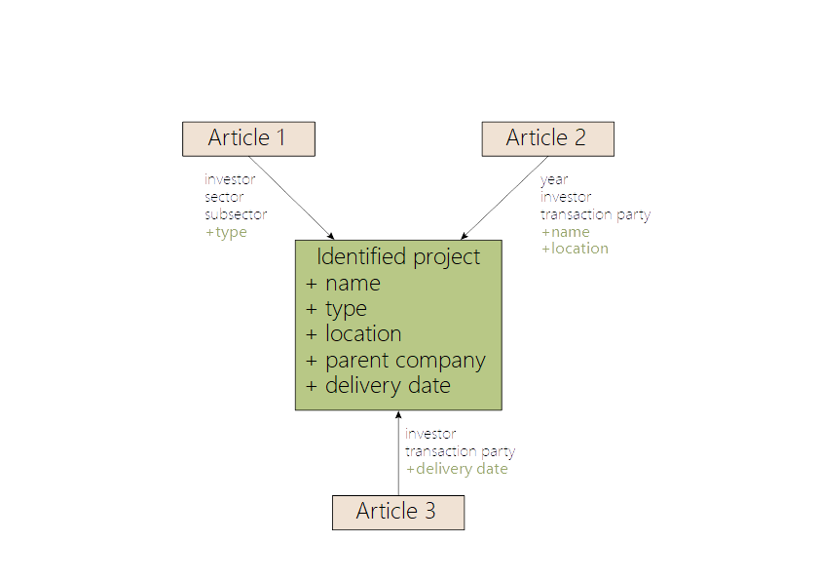
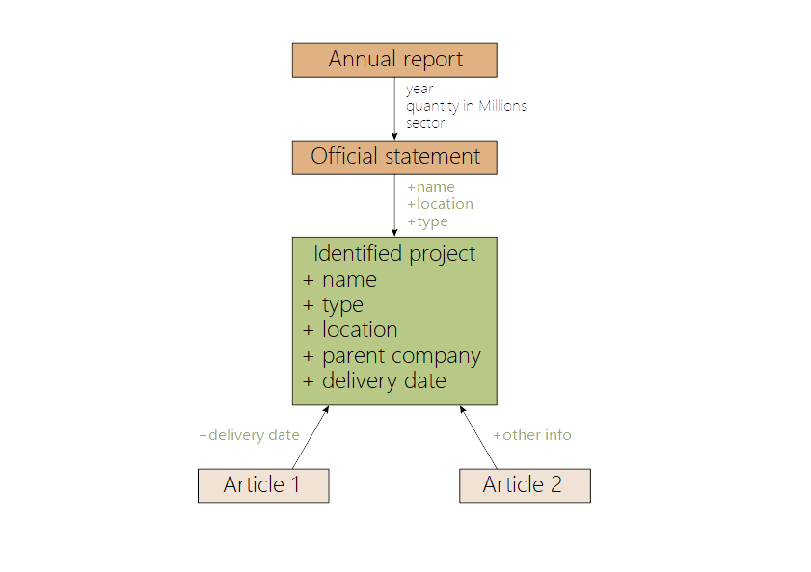
Methodology
The two methods for identifying a project
→ Analysis of official documents and matching articles
→ Cross-referencing of press articles

